Slide 1
Gramener Case Study

Slide 2
Problem Statement
A Lending company is facing financial loss (called credit loss) which is a the amount of money lost by the lender when the borrower defaults (refuses to pay or runs away with the money owed). The company wants to understand the driving factors (or driver variables) behind loan default, i.e. the variables which are strong indicators of default.

Slide 3
Analysis Approach
Using Exploratory Data Analysis, visually identify the variables having most impact on loan defaults.
The variables are identified using the differences in patterns observed between the Fully Paid and Charged Off (Defaulters) categories.

Slide 4
Data
Data comes from Gramener and it comprises of
39717 records of loans.
Observations include information such as Loan id, Member id, Interest rate, Loan amount, Monthly Instalment, Loan term, Open accounts, Loan purpose etc.
Totally 111 variables are there of which 54 are completely NAs.

Slide 5
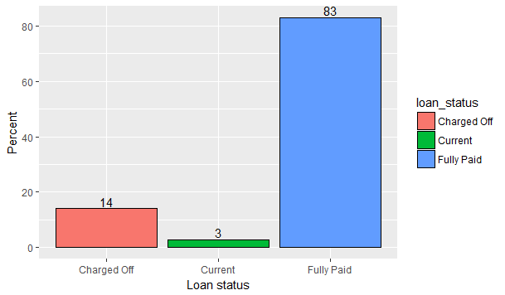
Distribution of Loan Accounts
As per the data,
roughly 14%
accounts are
defaulted accounts
with 83% being in
the Fully Paid
category

Slide 6
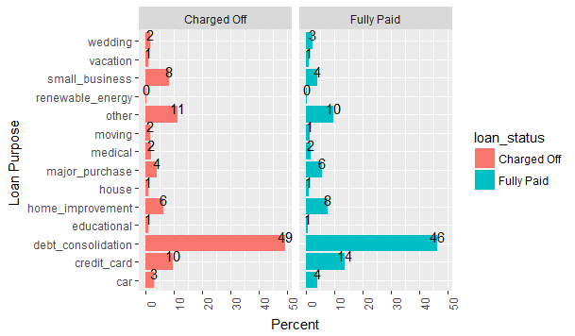
Purpose of Loans
The patterns in the
Defaulter and Fully paid
categories are almost
same except for loans
taken for Small
Business where the
Defaulters percentage
Is twice that of the
Fully paid category.

Slide 7
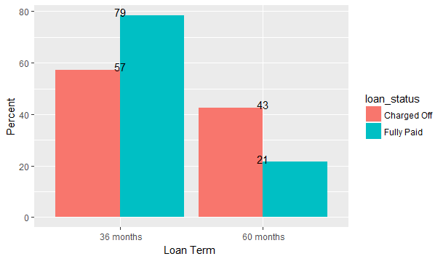
Loan Term
From the graph, it is
clear that while the
percentage of 60 month
loans is 21 in Fully paid
loans, it jumps to 43
percent in the Default
category indicating that
loan accounts with
60 months term are
twice as likely to default.
Thus Loan term = 60 is a predictor of default.

Slide 8
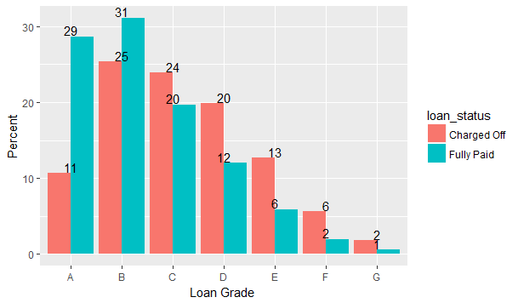
Loan Grade
Percentage of Loans
with Grade D to G is
almost double in the
Defaulters category
indicating that Grade D
to G loans are twice
as likely to default.
Thus Loan grade can
be an indicator of
Default.

Slide 9
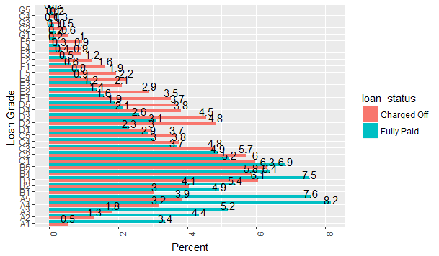
Loan Sub-grade

Slide 10
Loan Sub-grade
The percentage of loans in the D2 to G5 sub-grades rise significantly in the Defaulters category indicating that sub-grades variable influences the probability of default. So, Loan Sub-grade can also be a predictor of
Default.

Slide 11
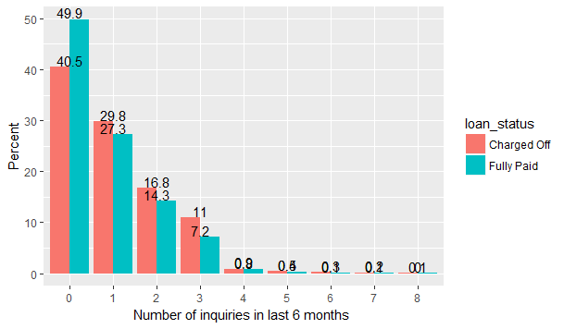
Loan Enquiry
Although the pattern
looks largely the same,
the percentage of loan
accounts with 3 inquiries
rises significantly by
more than 50% in the
Defaulters category

Slide 12
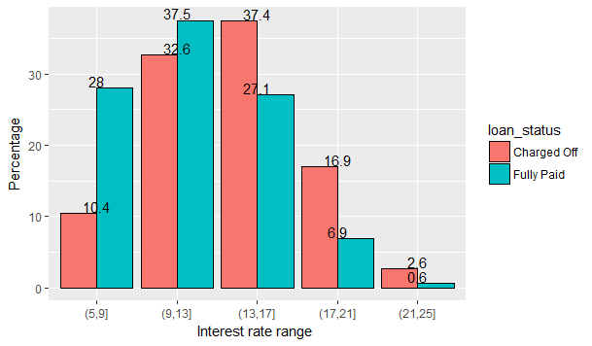
Interest Rate
The proportion of
defaults increase
once the interest
rate crosses 13%.
Infact, the
proportion of
defaults increase
2.5 times to 4.5
times as the
interest rate crosses 17%. Thus interest rate can be a
strong predictor of default.

Slide 13
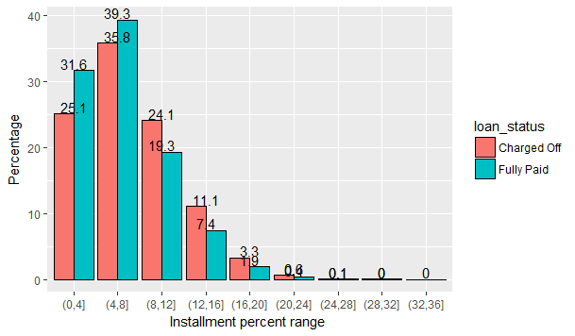
Instalment as a per-cent of monthly income
The proportion of
defaults is lower
in the 0 - 8%
range while it
rises by about
25% in the
8-12% range and
by about 50% in
12- 16% range to almost by 74% in the 16-20% range.
Thus, Instalment per-cent can be a strong predictor of
default.

Slide 14
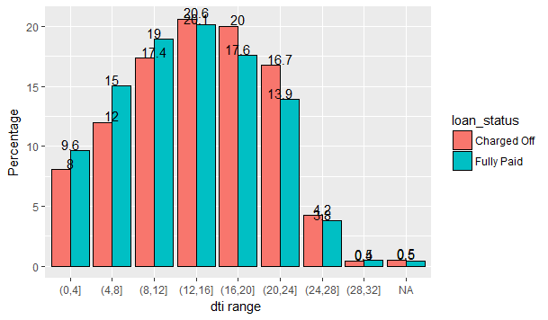
Debt to income ratio, dti
There is a rise of
almost 13% in
defaults once
dti is in the
16-20% range and
defaults rise by
about 20% in the
20-24% range.
Thus high dti can
also be a predictor of default.

Slide 15
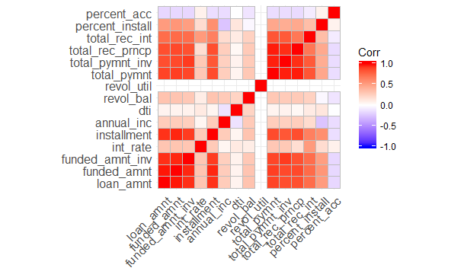
Correlation between Variables
Variables
which are
highly
correlated
cannot both
be taken as
predictor
variables. One
of the
variables will
have to be dropped.

Slide 16
Summary
Following variables can be predictors of default and need to be tested further for statistical significance.
Loan Term equal to 60 months
Loan Grades D to G.
Loan Sub-grades D2 to G5.
Interest rate greater than 13%.
Instalments as a percentage of monthly income greater than 8%.
Dti greater than 16%.
Purpose of Loan is Small Business.
Loan enquiries in last 6 months is equal to 3.

Slide 17
Recommendations
Should the Selected variables come out as Statistically significant, the lending company should screen for these variables at the time of loan application.
It should reduce its exposure in the 60 months loans, loans to small businesses, loans with grade from D to G,
Dti greater than 16% and instalments as a percentage of monthly income greater than 8%.
If it has to give such loans, it should give lower amounts or charge higher rates and demand some kind of collateral as well.

